Slide 1
To replace with my own drawing

Slide 2
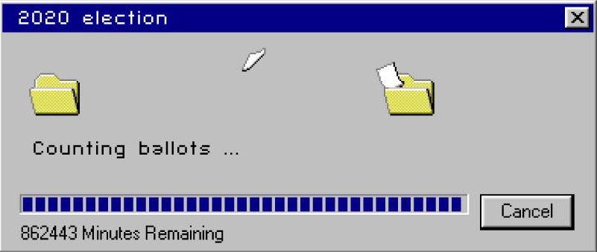

Slide 3
CSS342 Data Structures, Algorithms, and Discrete Mathematics (I)

Slide 4
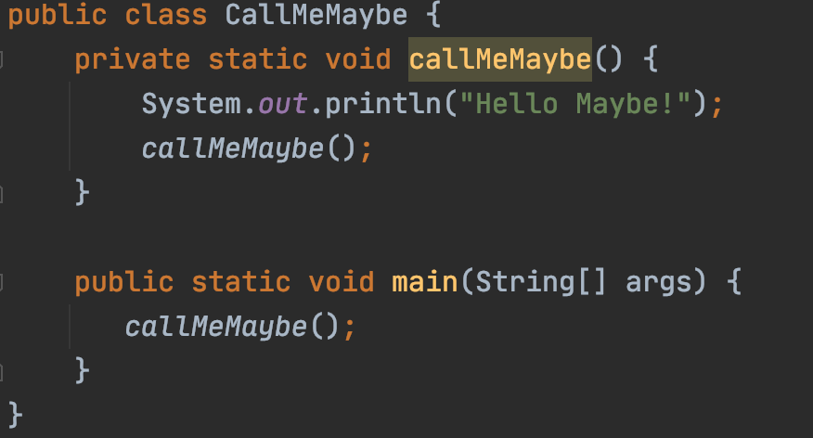
Dream in Recursion

Slide 5
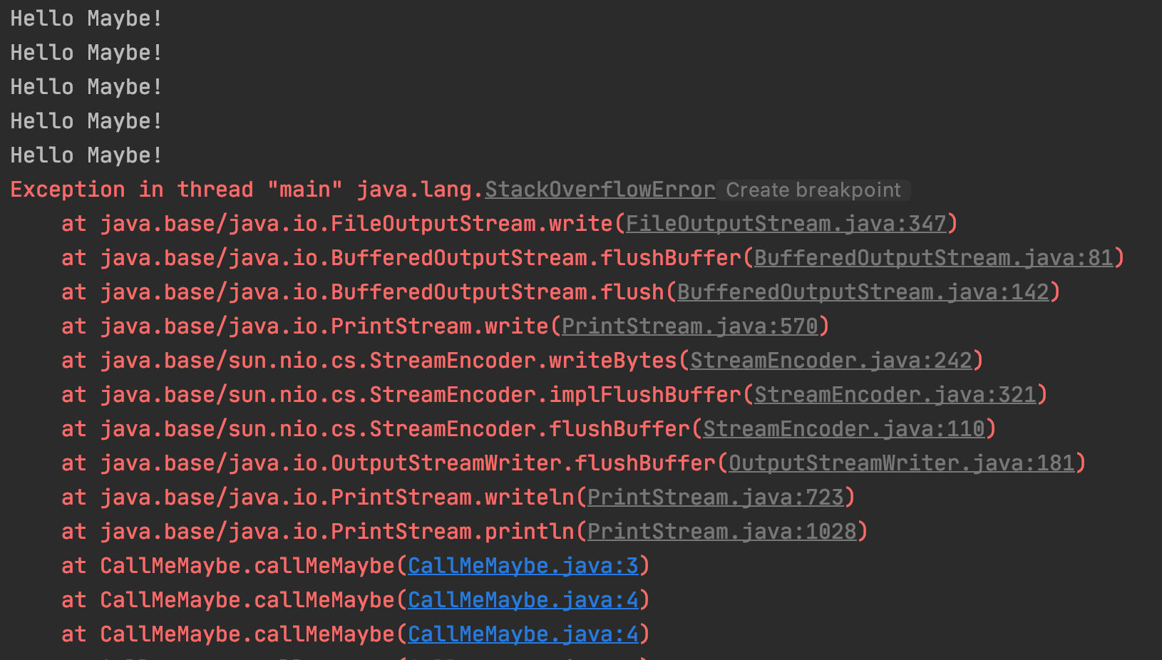
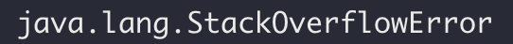
Dream in Recursion

Slide 6
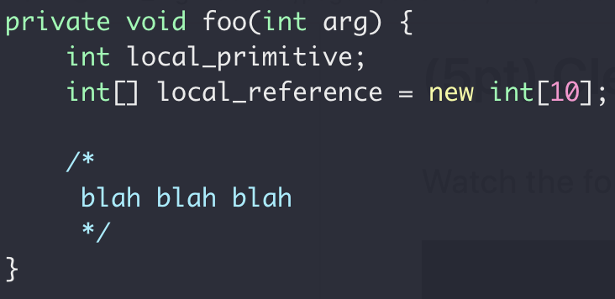
Function Call Stack
Heap
Int[10]
Stack
local_primitive
local_reference
Memory

Slide 7
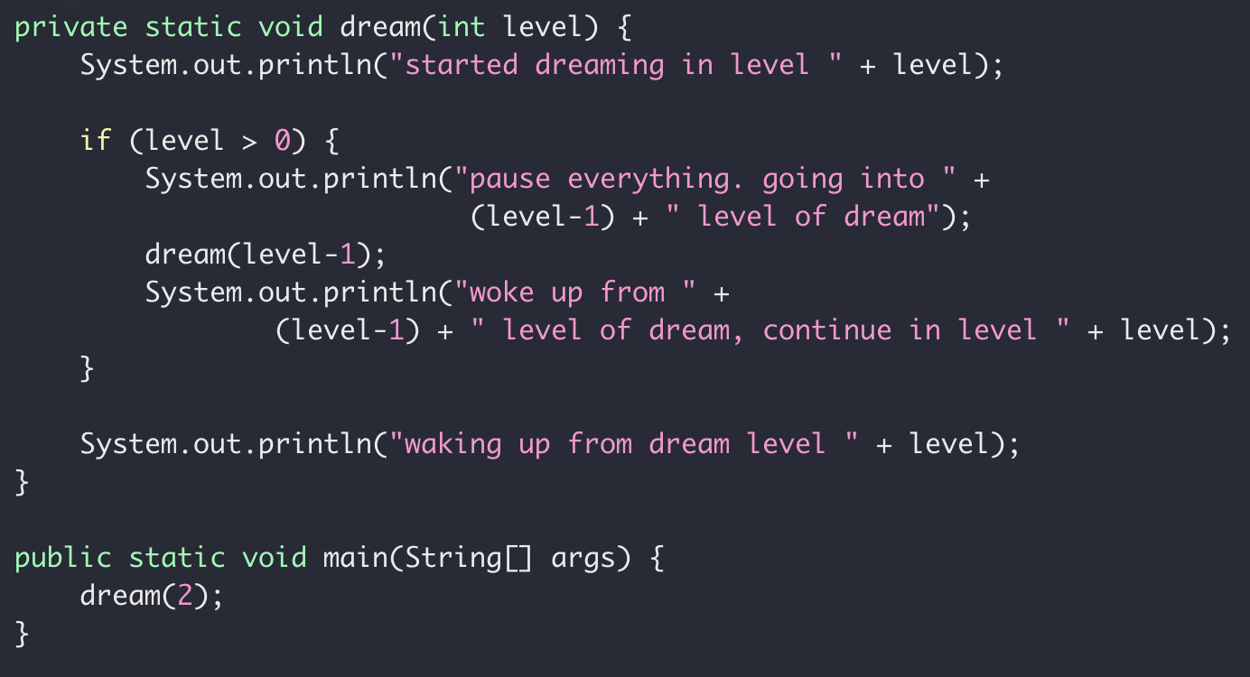
Function Call Stack
Heap
Ret address
2nd round
Stack
1st round
Memory
Same code segment
Different run time state stored in memory stack

Slide 8
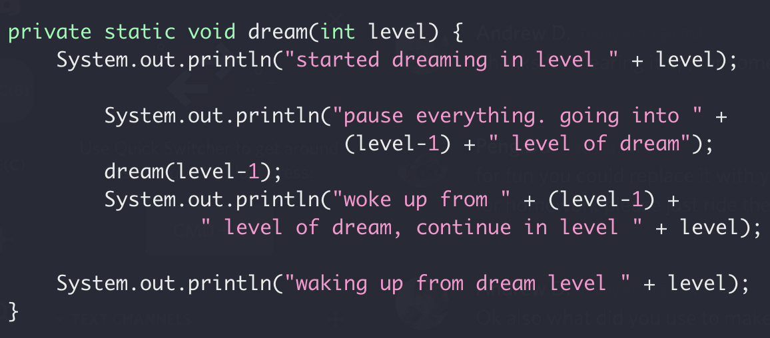
Function Call Stack
Heap
dream(2)
dream(1)
Locals for dream(0)
Return address of dream(1)
Locals for dream(1)
Stack
Return address of dream(2)
Locals for dream(2)
dream(0)
Return address of main()
Only one copy of dream(int)
Memory
More on function call
Stack buffer overflow attack
Notes:
http://www.pythontutor.com/visualize.html#mode=display

Slide 9
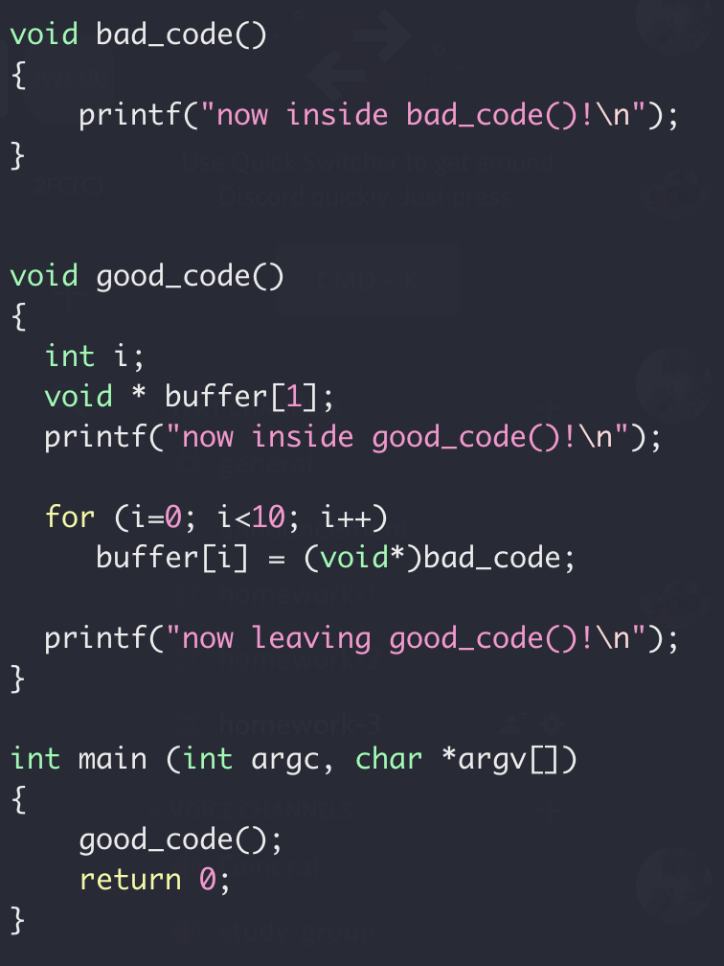
Function Call Stack
Locals for dream(1)
Stack
Return address of dream(2)
Locals for dream(2)
Return address of main()
Memory

Slide 10
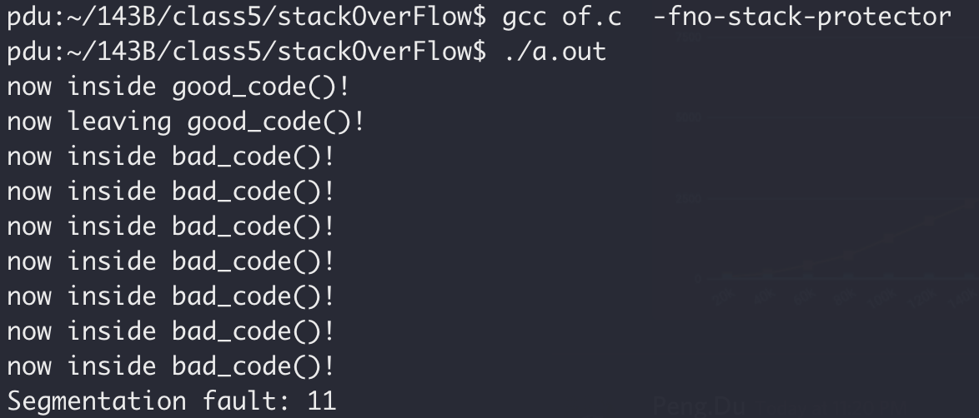
Stack Overflow Attack
Stack smashing

Slide 11
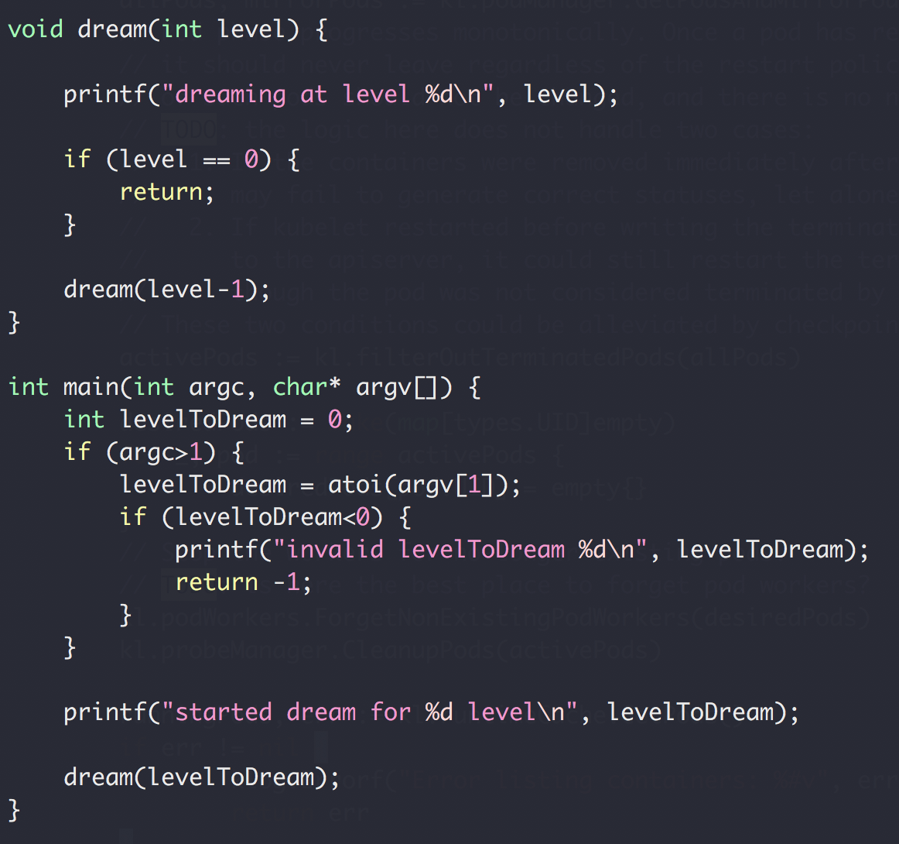
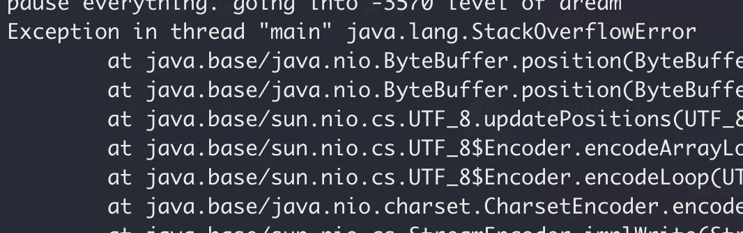
Function Call Stack
Heap
dream(N-4)
Return address of dream(N-3)
dream(N-3)
Return address of dream(N-2)
dream(N-2)
Return address of dream(N-1)
Stack
dream(N-1)
Return address of main()
main()
Memory

Slide 12
Recursion Summary
Function call itself
Each call has its own layer (call stack)
Stop the recursion somewhere

Slide 13
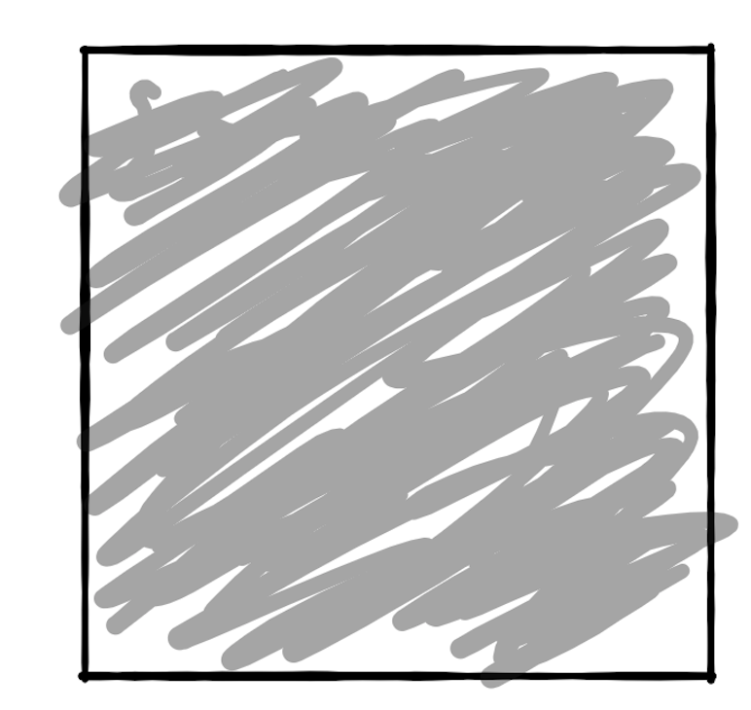
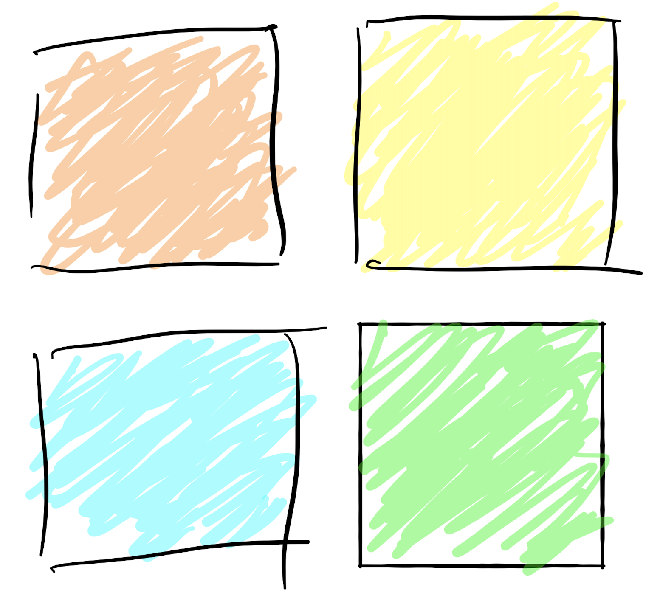
Recursion Summary
When to use recursion
Divide and Conquer

Slide 14
Recursion Summary
When to use recursion
Divide and conquer
1
3
5
7
9
10
12
12
14
14
18

Slide 15
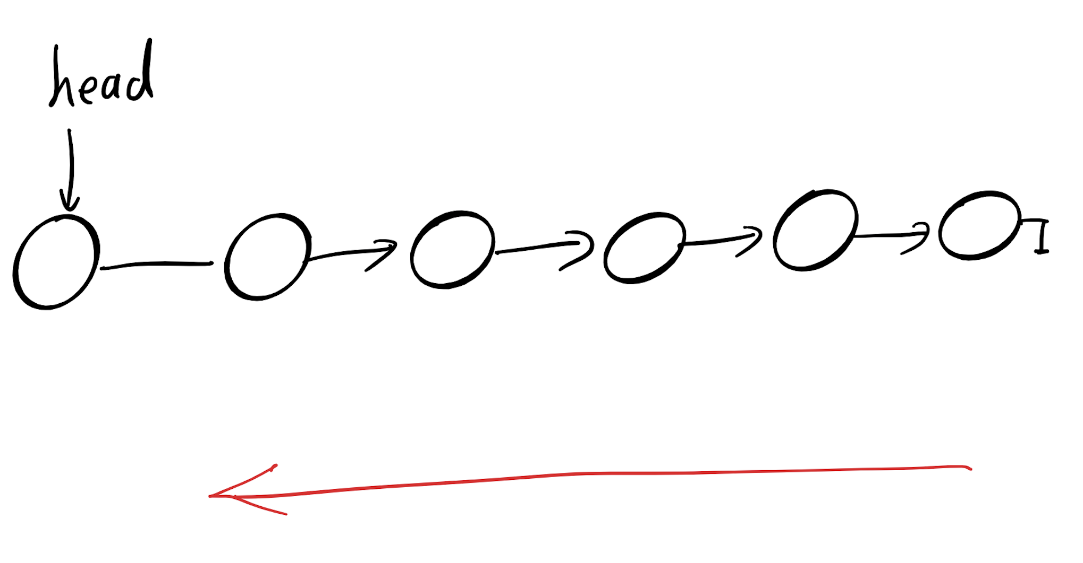
Recursion Summary
When to use recursion
Depth First Search

Slide 16
Recursion Summary
When to use recursion
Try All Options
?
?
?

Slide 17
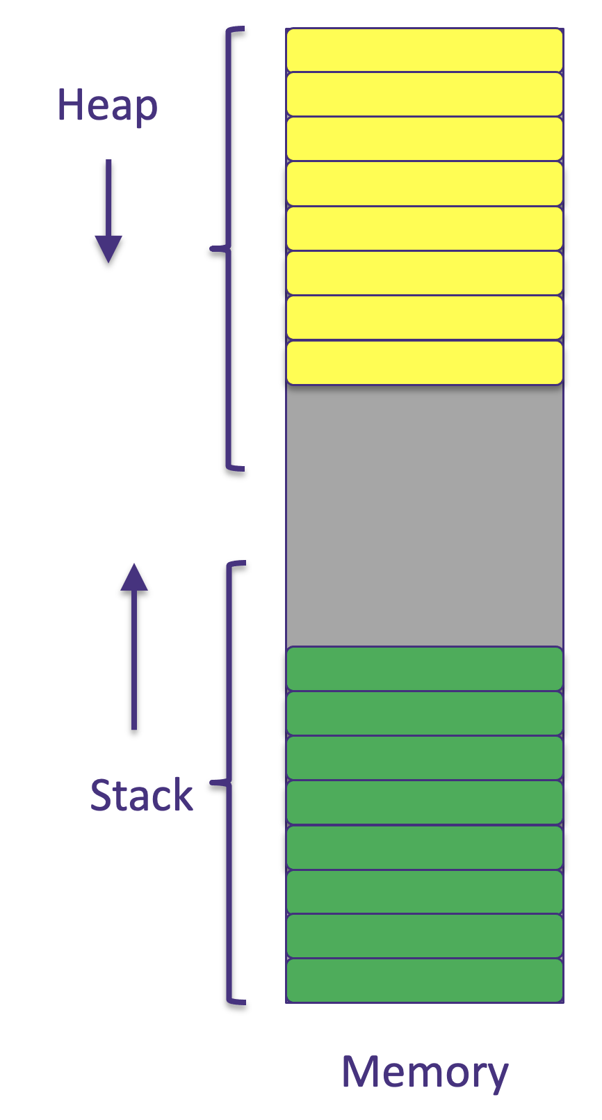
Recursion Summary
Stack size of memory is usually limited (smaller than heap)
Function call overhead
Stack Overflow Attack Risk

Slide 18
How many of these do you recognize now?
To replace with my own drawing

Slide 19
What we have learned so far?
ADT (array vs list)
One-dimensional ADT
Stack
Single linked list
Queue
Hash table
Recursion
Search Problem
Sorting
Binary tree
multi-dimensional ADT

Slide 20

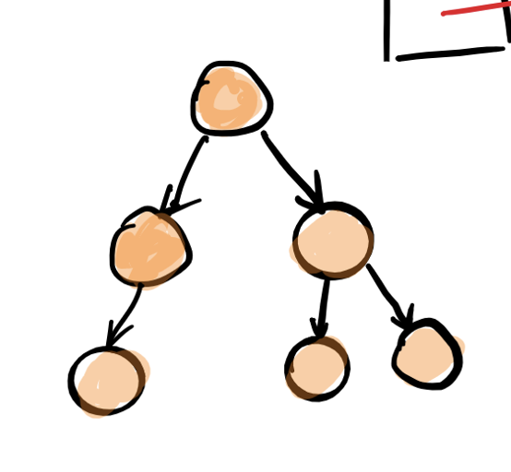

Slide 21
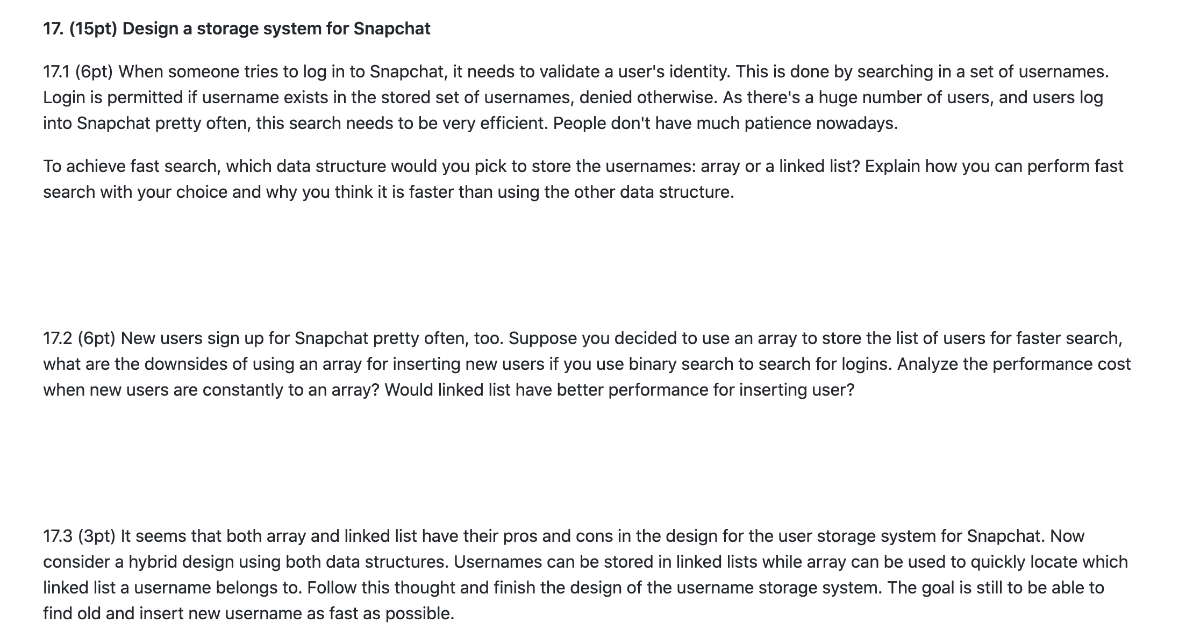

Slide 22
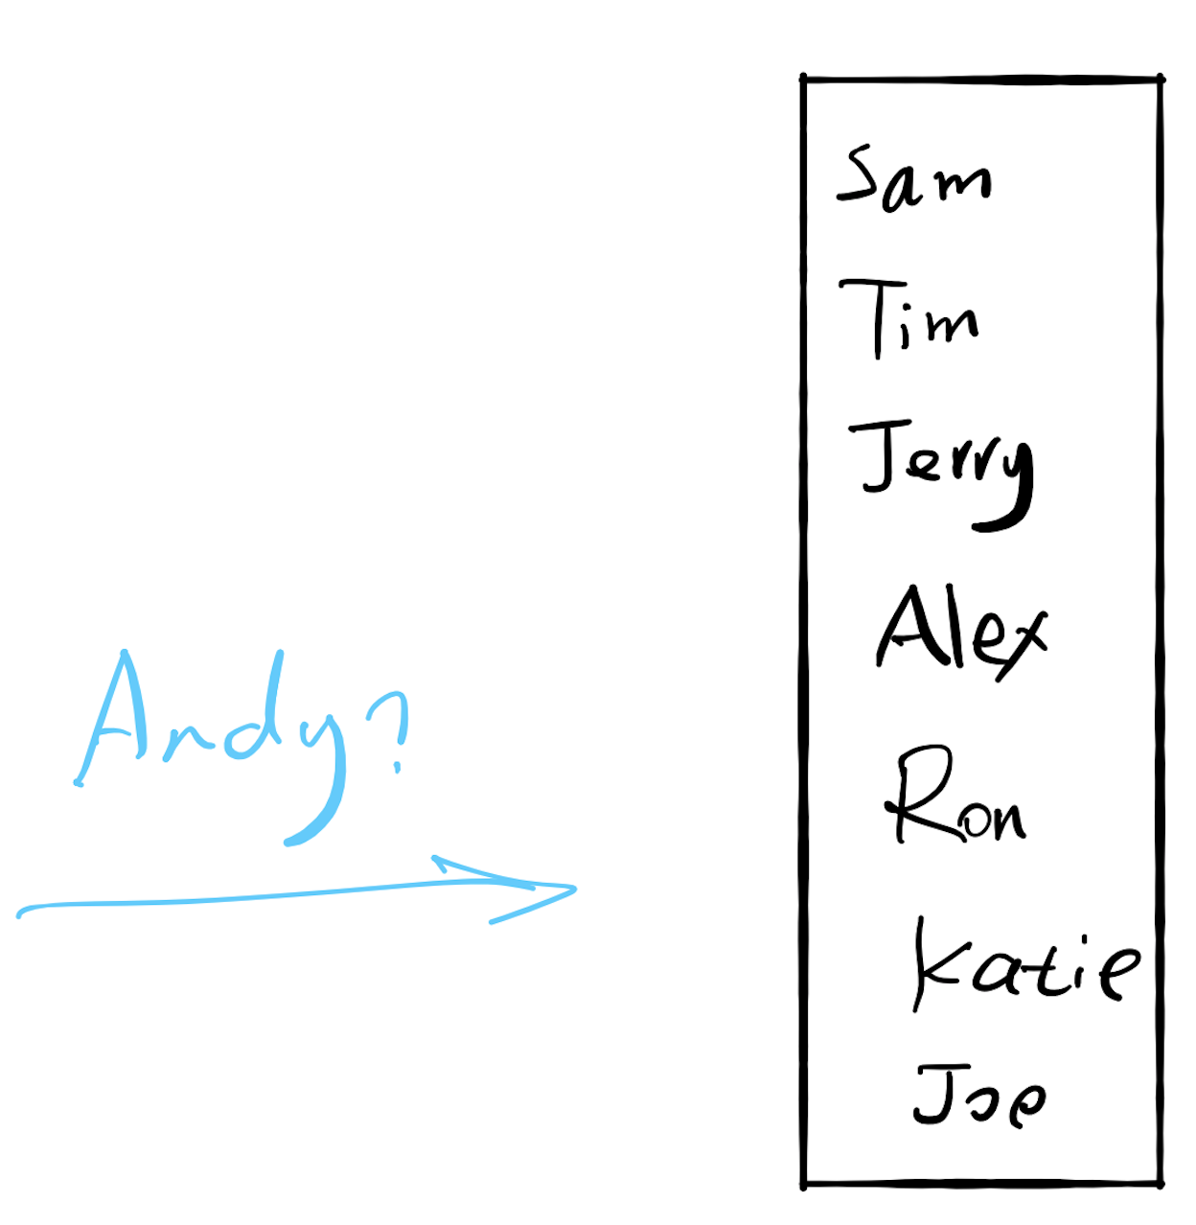

17.1 Search

Slide 23
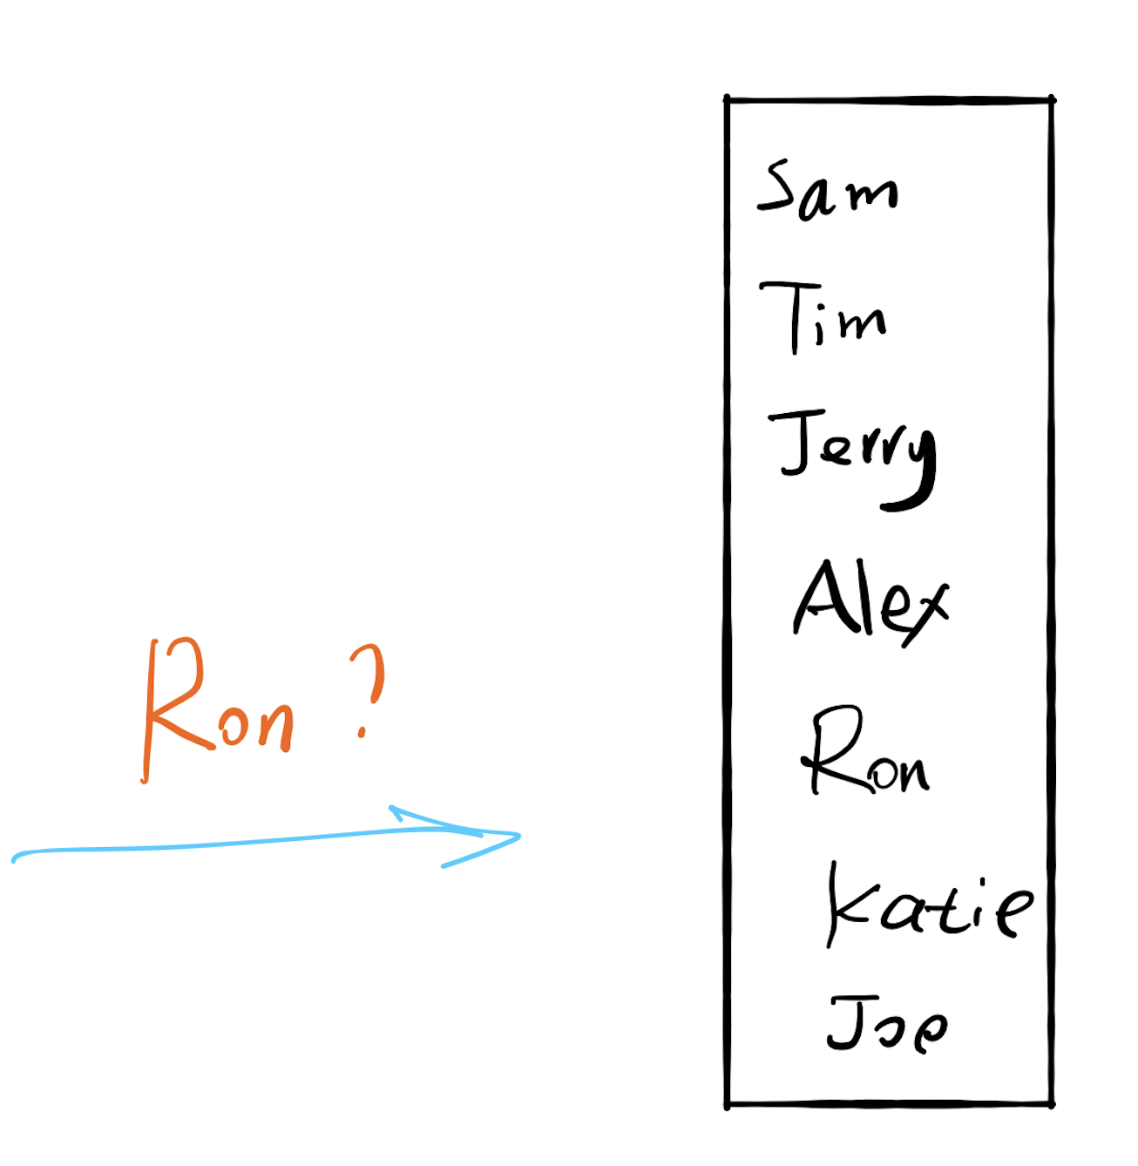

Slide 24
If there are 100 users
Each comparison takes 1 seconds
Worst case: 100 seconds (1.7 minutes)

Slide 25
If there are 10,000 users
Each comparison takes 1 seconds
Worst case: 10,000 seconds (2.8 hours)

Slide 26
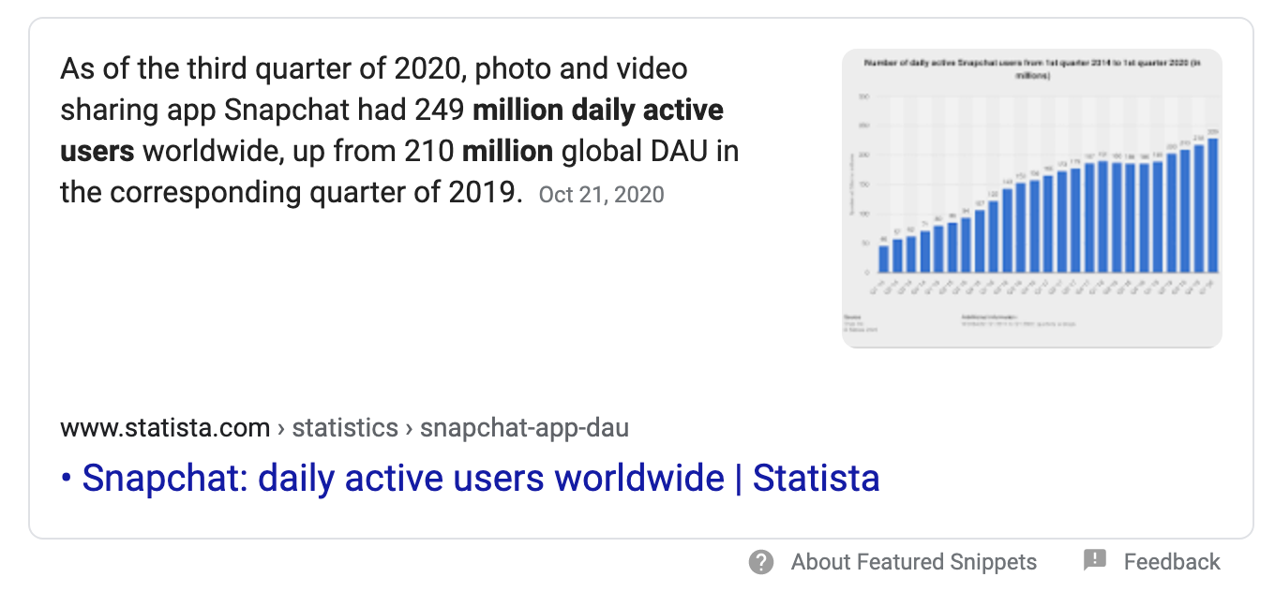
If there are 249 million users
Each comparison takes 1 seconds
Worst case: How long?

Slide 27
If there are 10,000 users
Worst case: 10,000 seconds (2.8 hours)
Can we do better?
Sort

Slide 28
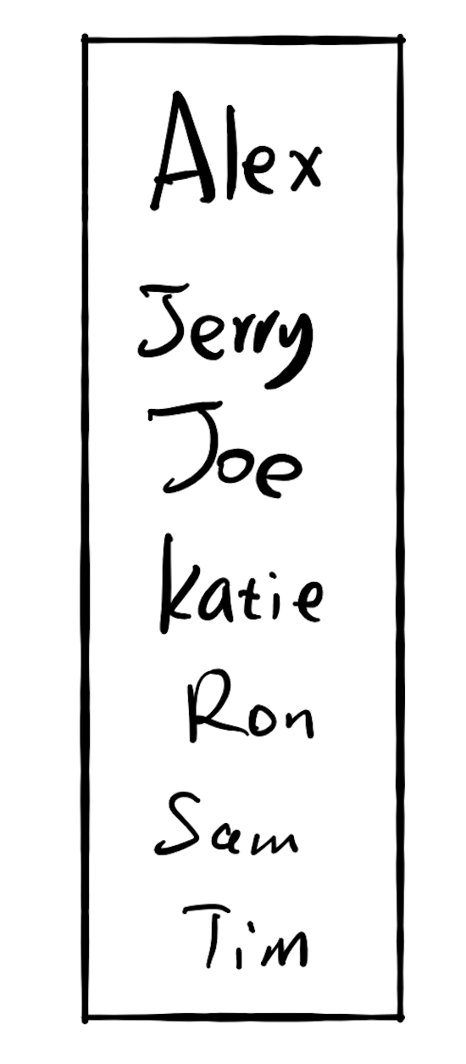
If there are 10,000 users
Worst case: 10,000 seconds (2.8 hours)
Worst case: 13.3 seconds

Slide 29
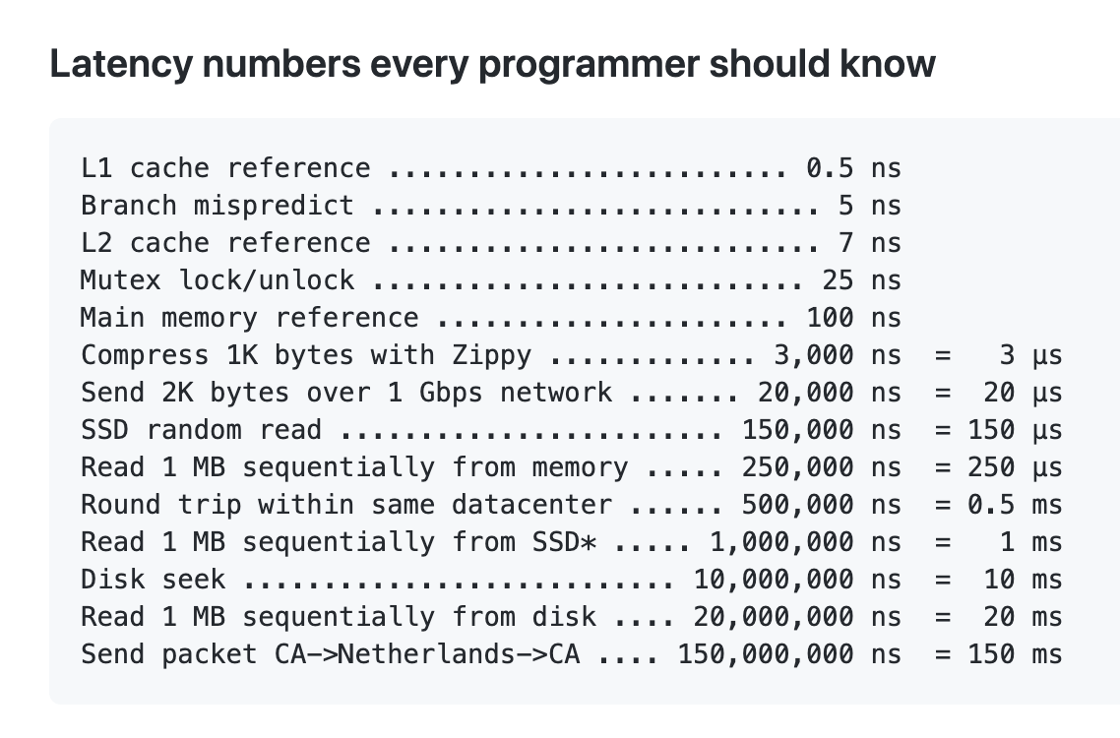
17.2 Insertion
If there are 10,000 users
Each memory ops takes 2 seconds
Because memory ops is slow
https://gist.github.com/hellerbarde/2843375

Slide 30
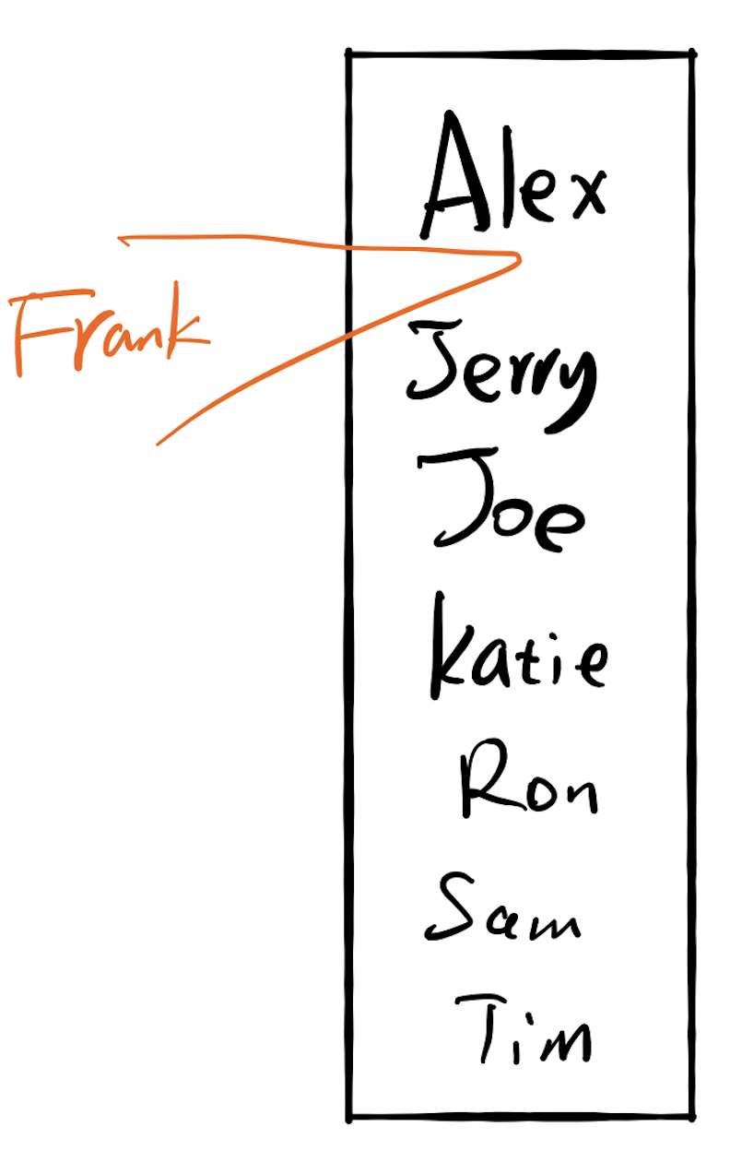
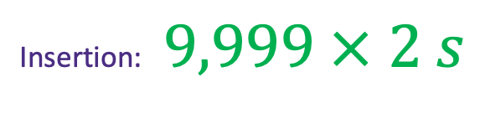
17.2 Insertion
If there are 10,000 users
Each memory ops takes 2 seconds
Search the location: 13.3 seconds
Insertion: $9,999 × 2 s$

Slide 31
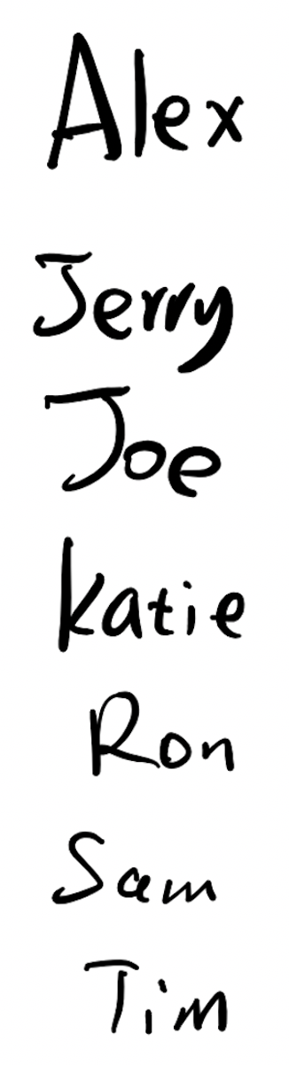

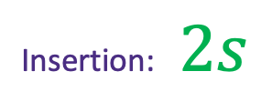
17.2 Insertion
If there are 10,000 users
Each comparison takes 1 seconds
Each memory ops takes 2 seconds
Insertion: $2s$
Search the location: ??

Slide 32
Fast for search
Slow for insertion
Slow for search
Fast for insertion

Slide 33
17.3 Do both fast?

Slide 34
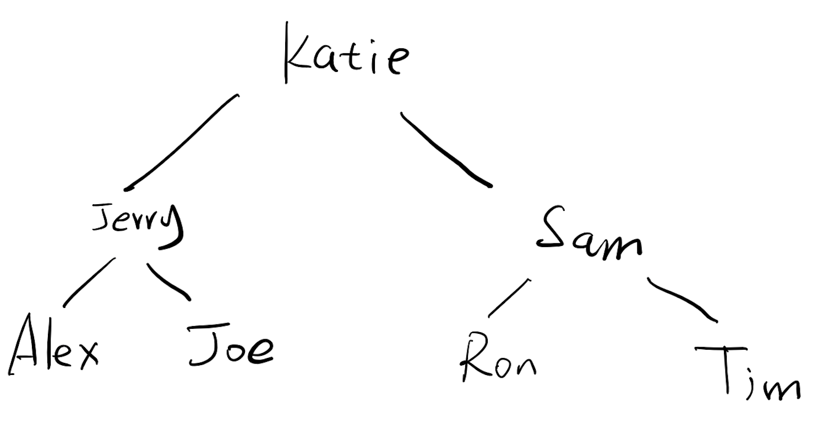
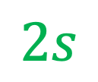
If there are 10,000 users
Each comparison takes 1 seconds
Each memory ops takes 2 seconds
Search the location:
13s
$$2s$$
Insertion:

Slide 35
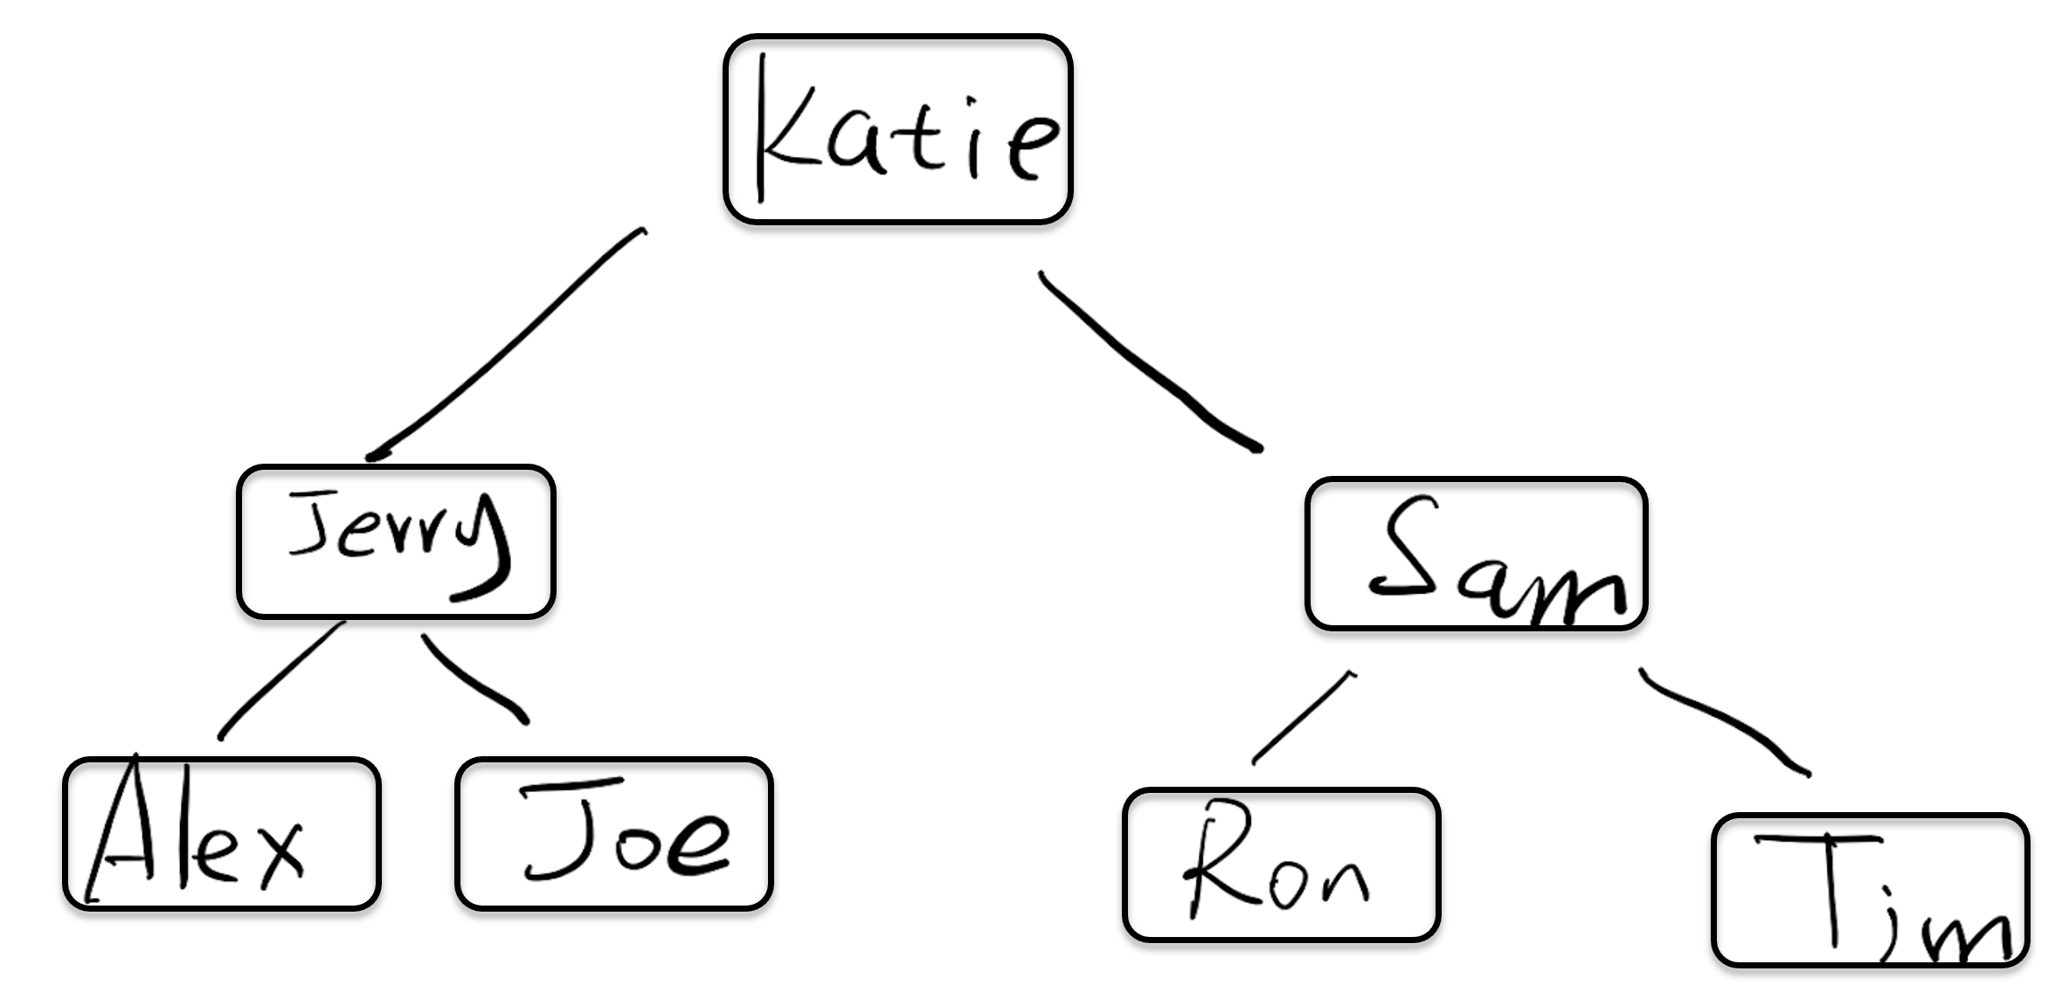
How do we implement this?

Slide 36
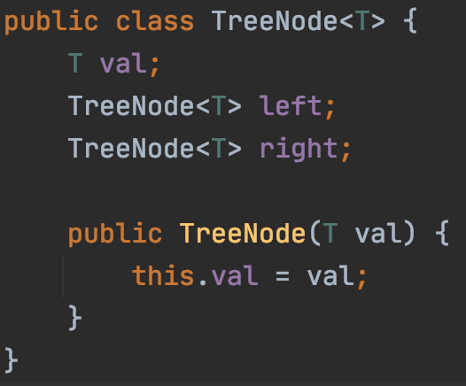

Slide 37
